Slide 1


Modelling
Music Recommendation
Lim Zi Yi
Wong Jing Hui
Lim Jia Le

Slide 2
Objectives
Predict whether a user would replay a song after listening to it for the first time, within a month.
Investigate the relationship between the users and the genre of the songs listened.
Analyse and predict what characteristics of songs that the user will prefer and recommend songs with similar features.
There are so many different songs!
What are the users’ preference?
A good song puts us in a good mood!

Slide 3
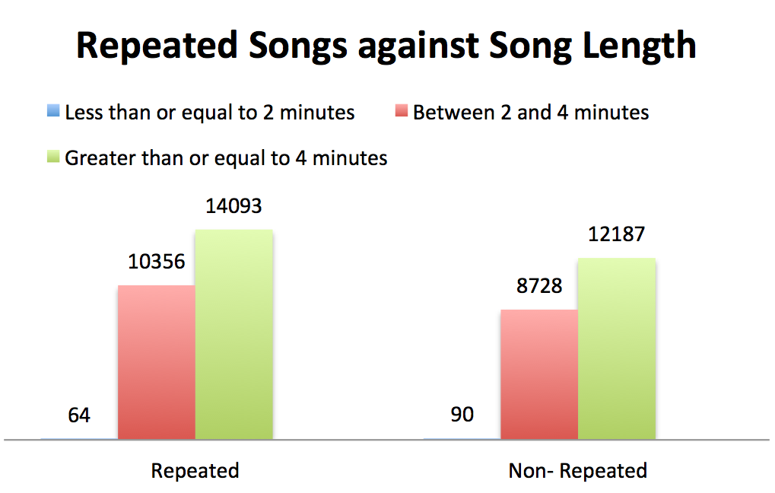
Data Set
Dataset of songs obtained from KKBOX:
Irrelevant information: Registration Time, Expiration Date
User information: Age, Gender, City, Registration methods
Song information: Song length, Genre, Artist, Lyricist, Language
WHAT ARE THE SIGNIFICANT VARIABLES
IN OUR PROJECT?

Slide 4
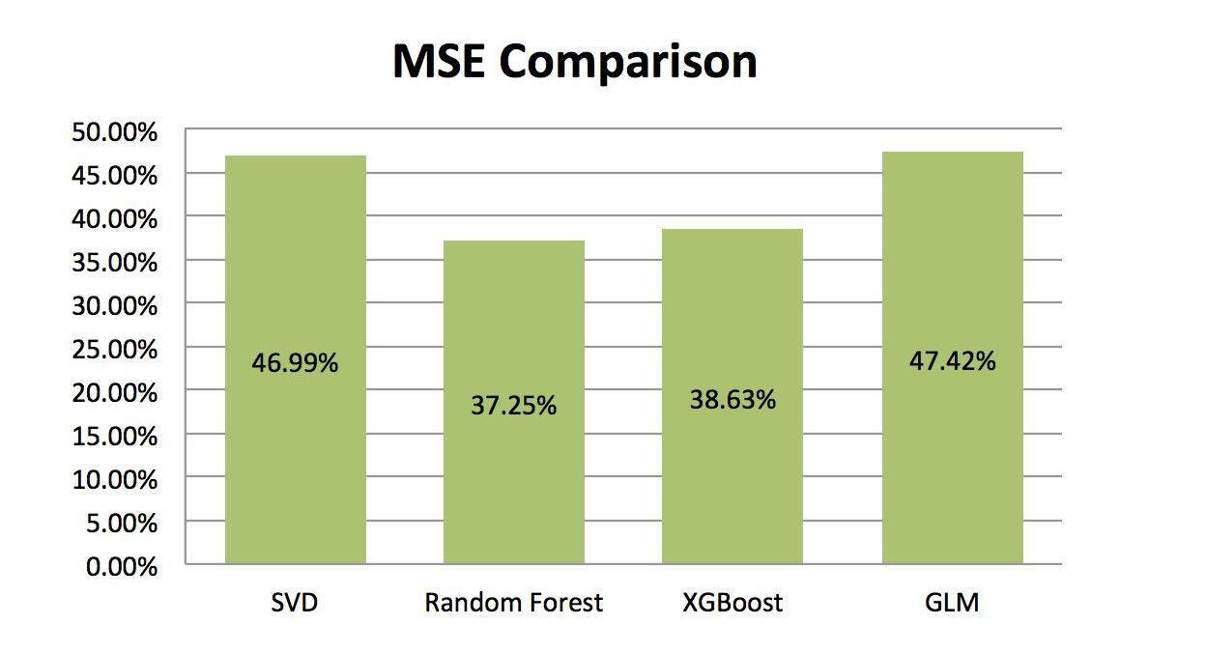
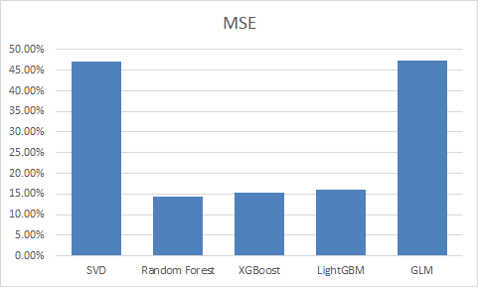
Methodology..
Singular Value Decomposition
Classification Tree
Logistic Regression
Probability as a linear combination of Singular Vectors
Overall limited prediction accuracy, below classification trees performed by Random Forest, XGBoost and LightGBM
Misclassification rate is 46.99%
Random Forest: Misclassification rate is 14.31%
XGBoost: Misclassification rate is 15.23%
LightGBM: Misclassification rate is 16.02%
Prediction is always ‘Replayed’
Misclassification rate is 47.42%

Slide 5
CONCLUSION!
Interpretation
Further Analysis
Classification Trees performed the best.
The Logistic Regression and SVD are quite close in terms of misclassification rate, but SVD has a higher interpretability.
The lyrics of the songs can be analysis via text mining.
Other methods such as Support Vector Machine and Artificial Neural Network can also be applied in this problem.

